Slide 1
The Project Financial Management
WBL 2.0

Slide 2
Main Documents
The most important documents concerning financial management are:
The Administrative and Contractual Provisions – Annex III to the Contract signed between the coordinator and the National Agency
The Agreement with the National Agency
The Agreement between the coordinator and the project partner

Slide 3
General Remarks

Slide 4
Accountancy
All costs and transactions must be registered systematically in the internal accountancy system of the institution.

Slide 5
Payments
All transactions must be carried out by bank transfer.
All payments in cash are to be avoided as they are not identifiable.

Slide 6
Supporting Documents
Supporting documents (invoices, contracts of employment, time sheets, receipts, purchase order, etc.) must be enclosed to the Financial report of expenditures
Only copies of supporting documents should be sent.
All original documents must be kept five years from the date of final payment.

Slide 7
Expenditures Model
Erasmus+ KA2 Strategic Partnership’s budget and reporting process are based both on:
Unit costs: Fixed amounts determined by the programme rules.
Real costs (only applies to Exceptional Costs)

Slide 8
Budget
The budget structure is the following:
Project Management and Implementation
Transnational Project Meetings
Intellectual Outputs
Multiplier events
Exceptional costs
Training initiatives

Slide 9
Eligible Costs
To be considered eligible costs MUST BE:
made during the project life cycle
necessary for implementation of the project and directly connected with the carrying out of the approved activities
identifiable and verifiable, i.e. justified with appropriate accounting documents and recorded in the partner institution accountancy system according to national legislation and internal practices

Slide 10
Ineligible Expenditure
The following costs are not eligible:
Return on capital
Debt and debt service charges
Interest owed
Expenditure already funded by Community sources
Excessive expenditure
Cost of buy out option at the end of lease periods
Contributions in kind from third parties
Cost of opening and operating Bank accounts
Deductible VAT

Slide 11
Transfer among headings
Beneficiaries are allowed to transfer up to 20% of the funds allocated, from a budget heading to another.
The 20% applies both on the category that is being reduced and the one that is being increased.
No transfer can be made to and from Project Management and implementation budget heading.

Slide 12
Erasmus +
Unit Costs Model

Slide 13
1. Budget for
Project Management and Implementation

Slide 14
Project Management and Implementation Definition
Project Management and Implementation budget heading includes all the transversal activities described in the Application to ensure the correct coordination of the project such as: evaluation, dissemination and exploitation.

Slide 15
Project Management and Implementation What does it cover
Activities such as:
Project management
Small scale learning/teaching/training events
Local project activities
Information, promotion and dissemination

Slide 16
Project Management and Implementation Amount
Coordinator: 500 Euro per month multiplied by the total numbers of project months
Partners: 250 Euro per month multiplied by the total numbers of project months

Slide 17
Project Management and Implementation Calculation
The final grant for each partner is calculated by multiplying the number of months of the project by the unit cost contribution.

Slide 18
Project Management and Implementation Reporting Documents 1/3
Description of the activities undertaken:
Activity reports
Dissemination reports
Exploitation reports
Brochures
Workshops
Etc.

Slide 19
Project Management and implementation Reporting Documents 2/3
The staff costs should be justified using:
Employment contract (clearly giving evidence to the formal link between the person and the institution)
Secondment Letter related to the project
Personal Time sheets
(related to activities for management and implementation)

Slide 20
Project Management and implementation Reporting Documents 3/3
Non staff costs should be justified using:
Invoice
Proof of payment

Slide 21
Project Management and implementation IMPORTANT!!!
1. Each partner’s grant is fixed and detailed in the Project Budget document.
2. All costs must be registered in the internal accountancy system of the institution and systematically associated to the project in the beneficiary accounts.

Slide 22
2. Budget for
Transnational Project Meetings

Slide 23
Transnational Project Meetings
Definition
Transnational Project Meetings are organized for project planning and management purposes as well as to assess the project in progress and final results.

Slide 24
Transnational Project Meetings
What does it cover
These costs are related to travel, accomodation and subsistence costs incurred by project partners’ representatives to participate in the TRANSNATIONAL meetings of the project Consortium.
Special provisions:
- Costs incurred by the hosting organisation are to be reported under Project management and implementation.
- Cost of project partners from the same country of the host, are eligible if the distance is above 100 km and if there are at least 2 participants from 2 different programme countries.

Slide 25
Transnational Project Meetings
Amount
Travel from 100 to 1999 km: 575 Euro per meeting per person
Travel above 2000 km : 760 Euro per meeting per person
Place of origin is understood as the place where the sending organisation is located and the place of venue as the place where the receiving organisation is located, any difference should be duly justified.

Slide 26
Transnational Project Meetings Calculation
The final grant for each partner is calculated by multiplying the unit cost by the number of participants to each meeting.
In all cases, the project partner shall be able to demonstrate a formal link with each person participating in the transnational project meetings.

Slide 27
Transnational Project Meetings
Reporting Documents 1/3
Declaration of the hosting institution specifying:
Name and surname of the participant
Purpose of the travel
Starting and ending date

Slide 28
Transnational Project Meetings
Reporting Documents 2/3
List of signatures
Meeting minutes and list of participants

Slide 29
Transnational Project Meetings
Reporting Documents 3/3
Extra supporting documents:
Flight ticket + Boarding cards
Hotel Invoice

Slide 30
Transnational Project Meetings
IMPORTANT!!!
1. Each partner’s grant is fixed and detailed in the Project Budget document.
2. All costs must be registered in the internal accountancy system of the institution and systematically associated to the project in the beneficiary accounts.

Slide 31
3. Budget for
Intellectual outputs

Slide 32
Intellectual Outputs
Definition
Intellectual Outputs are the main tangible results proposed in the Grant Application and approved by the National Agency.
Intellectual Outputs are expected to be: innovative, consistent and transferable.

Slide 33
Intellectual Outputs
What does it cover
Costs for Intellectual Outputs are to cover the staff working days needed to produce the Intellectual outputs.
To report the cost in this category the formal link with the staff member involved in the production of the Intellectual Outputs should be demonstrated.
Service contracts are not eligible.
N.B. Staff costs for managers and administrative staff are covered under "Project management and implementation".

Slide 34
Intellectual Outputs
Amount 1/2
Number of planned and approved working days per staff category per partner, multiplied by the unit costs according to the table published within the call.

Slide 35
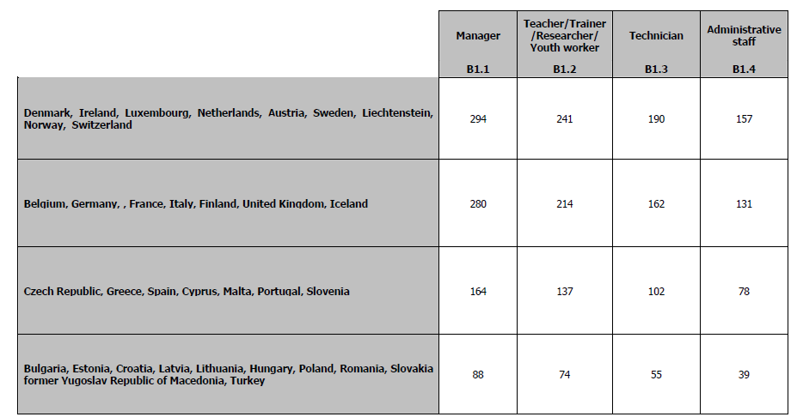
Intellectual Outputs
Amounts 2/2

Slide 36
Intellectual Outputs Calculation
The final grant for each partner is calculated by multiplying the number of days of work performed by the staff of the project partner as from time sheets, multiplied by the Unit costs (of the related staff category), according to the table (see slide before).

Slide 37
Intellectual Outputs
Reporting Documents 1/3
Evidence of the intellectual output produced and of its consistency with the planned description outlined in the project proposal.

Slide 38
Intellectual Outputs
Reporting Documents 2/3
Proof of the nature of the formal relationship between the staff member, whose cost is reported, with the beneficiary:
Contract (giving evidence to the formal link between the person and the institution and the coherence with the staff category)
Secondment letter
Registration in the official records of the beneficiary

Slide 39
Intellectual Outputs
Reporting Documents 3/3
Proof of the staff time invested for producing the intellectual output(s) through time sheets identifying:
Name of the person
Staff category
Number of days implemented for IO(s) production
Dates
Specific activities carried out

Slide 40
Intellectual Outputs
IMPORTANT!!!
1. Each partner’s grant is fixed and detailed in the Project Budget document.
2. All costs must be registered in the internal accountancy system of the institution and systematically associated to the project in the beneficiary accounts.

Slide 41
4. Budget for Multiplier events

Slide 42
Multiplier Events
Definition
Multiplier Events involve a consistent number of stakeholders and must aim to promote the use of the Intellectual Outputs.

Slide 43
Multiplier Events What does it cover
Organisation of national and transnational conferences/seminars/events aimed at sharing and disseminating the intellectual outputs produced by the project.
Support for multiplier events is provided only if in direct relation to the intellectual outputs of the project.

Slide 44
Multiplier Events Amounts
100 Euro per local participant
200 Euro per international participant

Slide 45
Multiplier Events Calculation
The final grant for each partner is calculated by multiplying the number of national/international participants by the corresponding amount in Euro

Slide 46
Multiplier Events
Reporting Documents 1/4
Participants’ name / surname / institution / institution address / participant e-mail address and signature.

Slide 47
Multiplier Events
Reporting Documents 2/4
For staff cost proof of the nature of the formal relationship between the staff member, whose cost is reported, with the beneficiary:
Contract
Secondment letter
Registration in the official records of the beneficiary

Slide 48
Multiplier Events
Reporting Documents 3/4
For staff cost proof of the staff time invested for producing the intellectual output(s) through time sheets identifying:
Name of the person
Staff category
Dates
Number of days dedicated to the organisation of Multiplier Events

Slide 49
Multiplier Events
Reporting Documents 4/4
Non staff costs should be justified using:
Invoice
Proof of payment

Slide 50
Intellectual Outputs
IMPORTANT!!!
1. Each partner’s grant is fixed and detailed in the Project Budget document.
2. All costs must be registered in the internal accountancy system of the institution and systematically associated to the project in the beneficiary accounts.

Slide 51
5. Budget for
Exceptional costs

Slide 52
Exceptional Costs
Definition
Exceptional Costs are related to:
- subcontracting of goods and services
- depreciation of equipment
- financial guarantees.

Slide 53
Exceptional costs What does it cover
Contribution to real costs related to subcontracting or purchase of goods and services
Subcontracting has to be related to services that cannot be provided directly by partners.
Equipment cannot concern normal office equipment

Slide 54
Exceptional costs Amount
75 % of real the cost of the good/service

Slide 55
Exceptional costs
Reporting Documents
Contract
Invoice
Proof of payment

Slide 56
Exceptional costs
ATTENTION!!! Not foreseen in the approved project and related budget.
NO RESOURCES AVAILABLE.

